Slide 1

Music Store Data Analysis
By Muhammad Waqas

Slide 2
Hello Everyone
I'm Muhammad Waqas
Welcome to my data analysis project!
In this project, I have showcased my SQL skills by performing an in-depth analysis on a music store dataset using PostgreSQL. The analysis covers a range of questions from basic to advanced levels, demonstrating my expertise in SQL and data analysis.

Slide 3
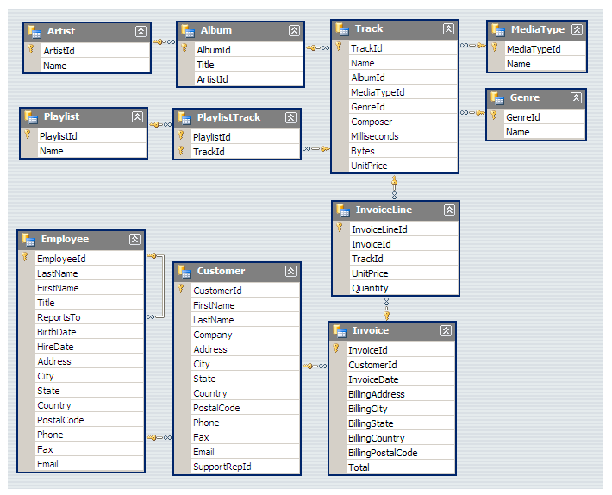
Schema

Slide 4
All Questions
Question Set 1 - Easy
Q1: Who is the senior most employee based on job title?
Q2: Which countries have the most Invoices?
Q3: What are top 3 values of total invoice?
Q4: Which city has the best customers? We would like to throw a promotional Music Festival in the city we made the most money.
Write a query that returns one city that has the highest sum of invoice totals.
Return both the city name & sum of all invoice totals
Q5: Who is the best customer? The customer who has spent the most money will be declared the best customer. Write a query that returns the person who has spent the most money.

Slide 5
All Questions
Question Set 2 – Moderate
Q1: Write query to return the email, first name, last name, & Genre of all Rock Music listeners. Return your list ordered alphabetically by email starting with A.
Q2: Let's invite the artists who have written the most rock music in our dataset. Write a query that returns the Artist name and total track count of the top 10 rock bands.
Q3: Return all the track names that have a song length longer than the average song length. Return the Name and Milliseconds for each track. Order by the song length with the longest songs listed first.

Slide 6
All Questions
Question Set 3 – Advance
Q1: Find how much amount spent by each customer on artists? Write a query to return customer name, artist name and total spent.
Q2: We want to find out the most popular music Genre for each country. We determine the most popular genre as the genre
with the highest amount of purchases. Write a query that returns each country along with the top Genre. For countries where
the maximum number of purchases is shared return all Genres.
Q3: Write a query that determines the customer that has spent the most on music for each country.
Write a query that returns the country along with the top customer and how much they spent.
For countries where the top amount spent is shared, provide all customers who spent this amount.

Slide 7

Set No. 01

Slide 8
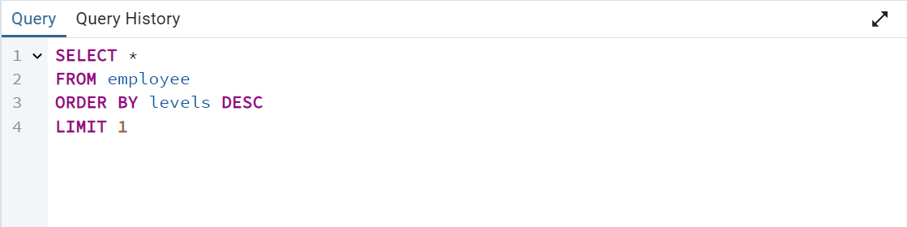
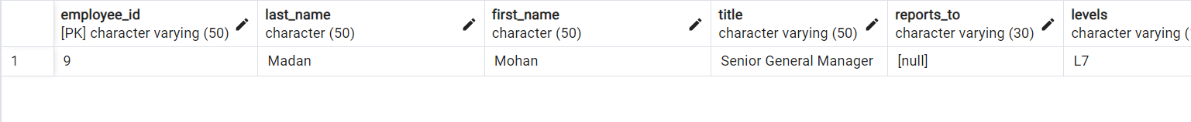
Q1: Who is the senior most employee based on job title?
Madan Mohan is the senior most employee as a Senior General Manager.

Slide 9
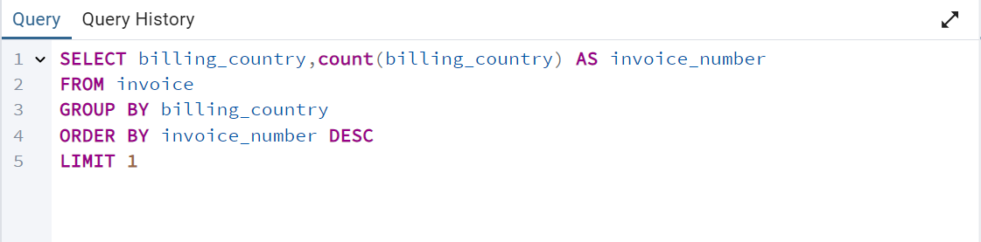
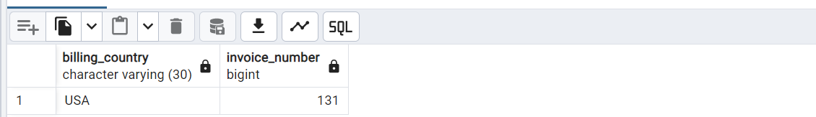
Q2: Which countries have the most Invoices?
USA have the most number of invoices.

Slide 10
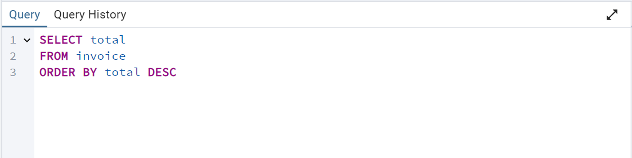
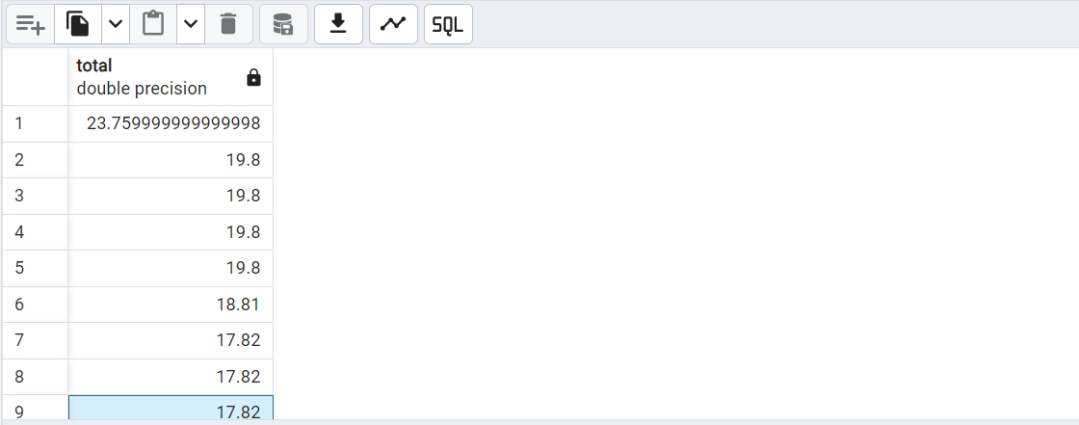
Q3: What are top 3 values of total invoice?
23.75999, 19.8 and 18.81 are top 3 values of total invoices.

Slide 11
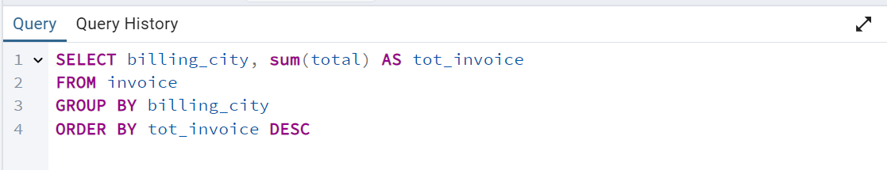
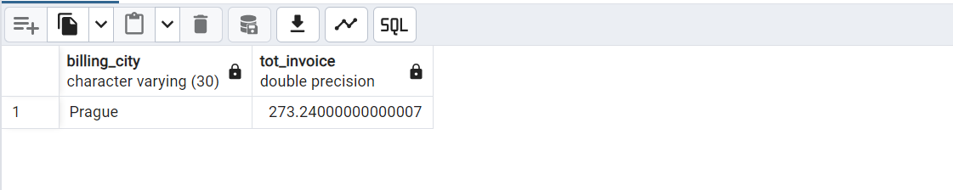
Q4: Which city has the best customers? We would like to throw a promotional Music Festival in the city we made the most money.
Write a query that returns one city that has the highest sum of invoice totals.
Return both the city name & sum of all invoice totals
Prague have best customers, We should throw Music Festival there.

Slide 12
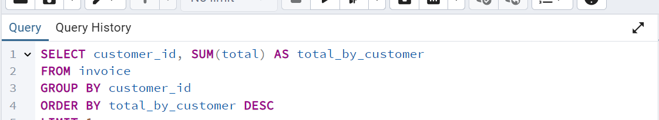
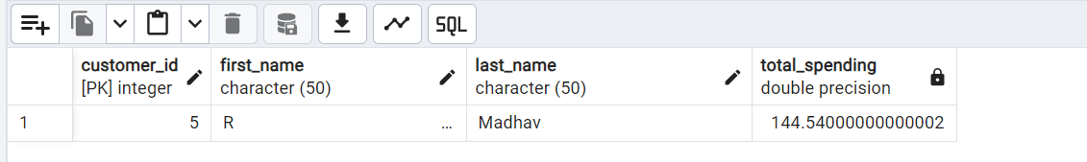
Q5: Who is the best customer? The customer who has spent the most money will be declared the best customer.
Write a query that returns the person who has spent the most money totals
Customer of id 5 is the best customer.

Slide 13
Set No. 02

Slide 14
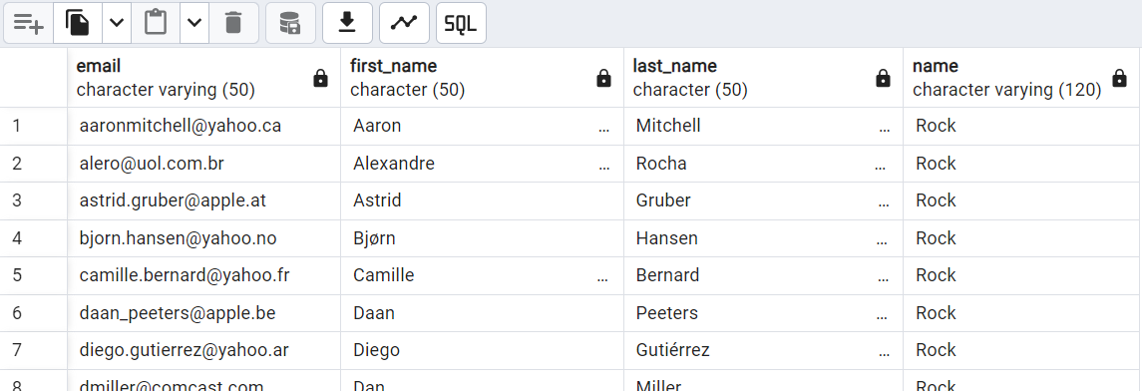
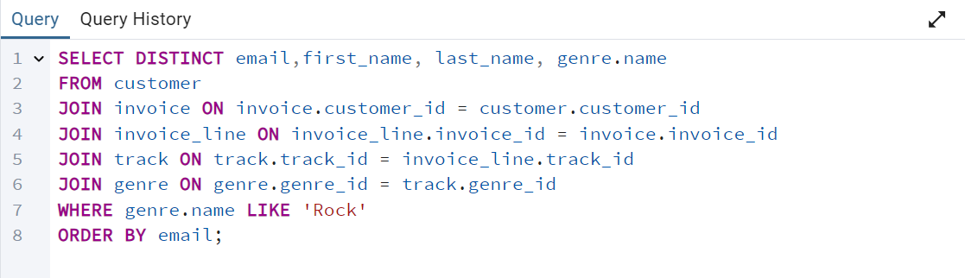
Q1: Write query to return the email, first name, last name, & Genre of all Rock Music listeners.
Return your list ordered alphabetically by email starting with A.

Slide 15
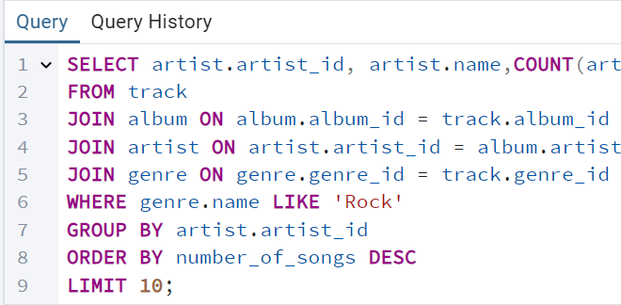
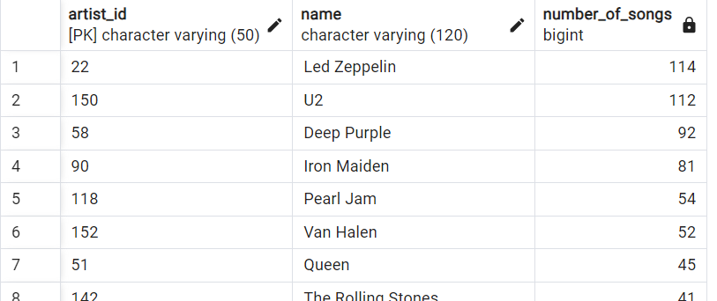
Q2: Let's invite the artists who have written the most rock music in our dataset.
Write a query that returns the Artist name and total track count of the top 10 rock bands.

Slide 16
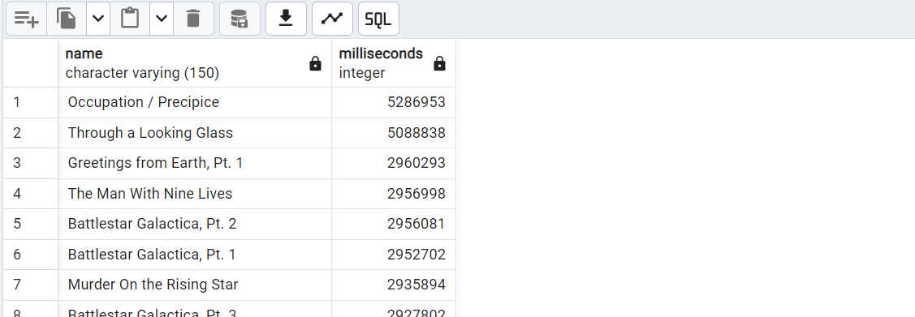
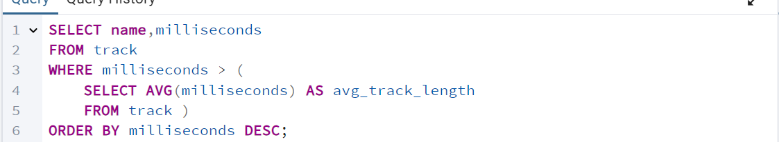
Q3: Return all the track names that have a song length longer than the average song length.
Return the Name and Milliseconds for each track. Order by the song length with the longest songs listed first.

Slide 17
Set No. 03

Slide 18
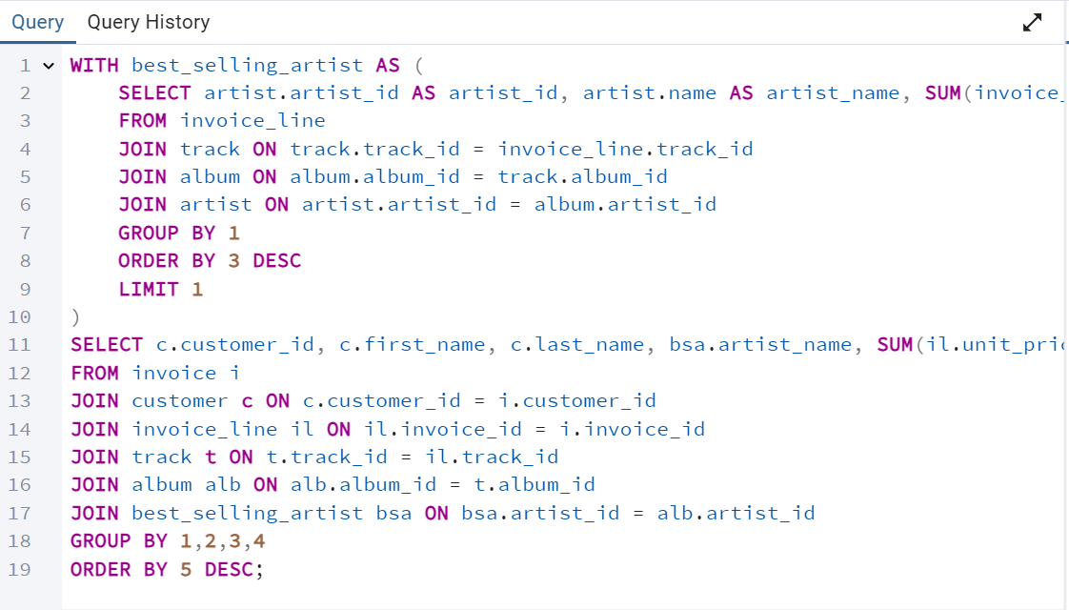
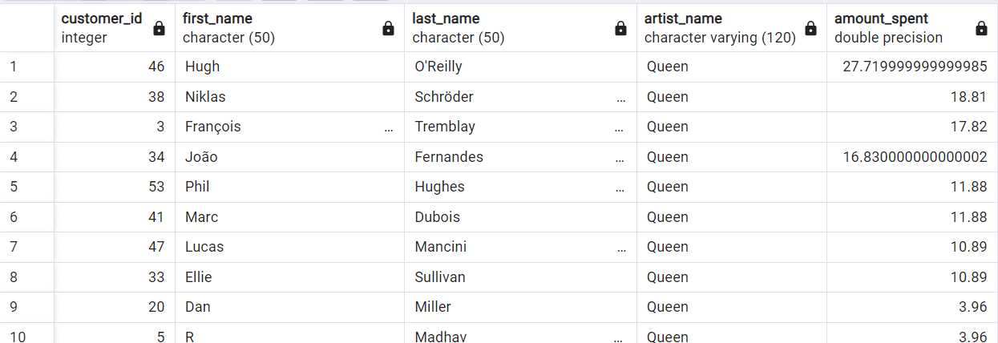
Q1: Find how much amount spent by each customer on artists? Write a query to return customer name, artist name and total spent

Slide 19
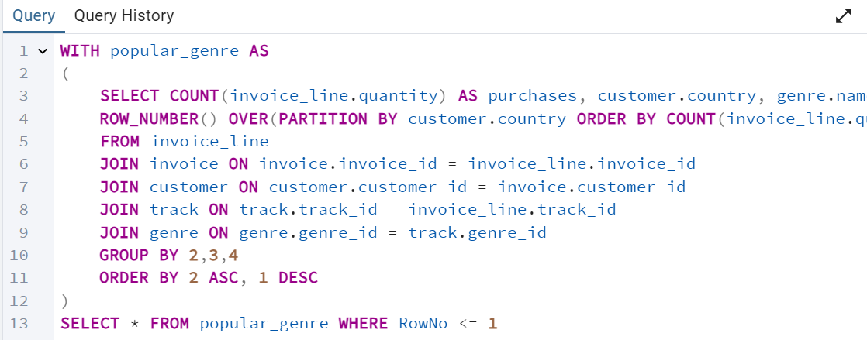
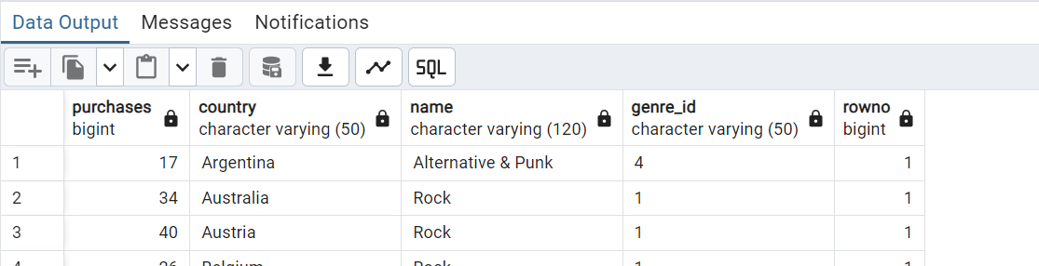
Q2: We want to find out the most popular music Genre for each country. We determine the most popular genre as the genre
with the highest amount of purchases. Write a query that returns each country along with the top Genre. For countries where
the maximum number of purchases is shared return all Genres.

Slide 20
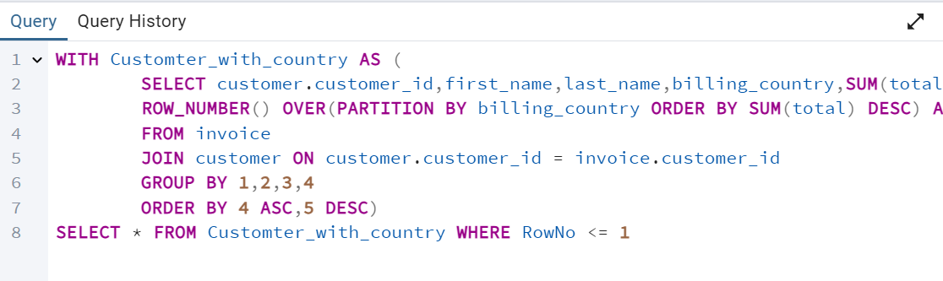
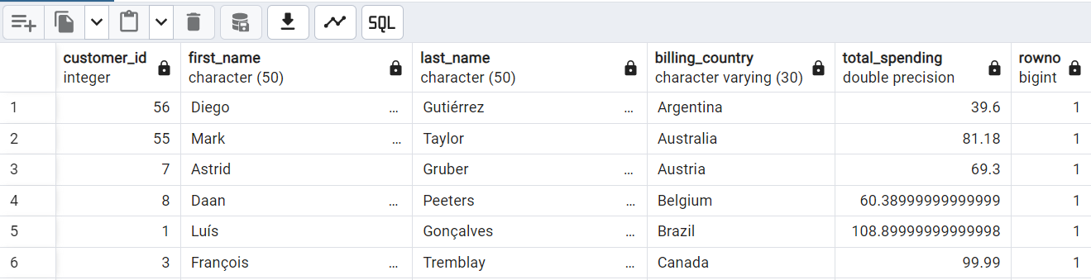
Q3: Write a query that determines the customer that has spent the most on music for each country.
Write a query that returns the country along with the top customer and how much they spent.
For countries where the top amount spent is shared, provide all customers who spent this amount. return all Genres.

Slide 21

Thank For Your Time

